Slide 1
Regression with a Single Feature

Slide 2
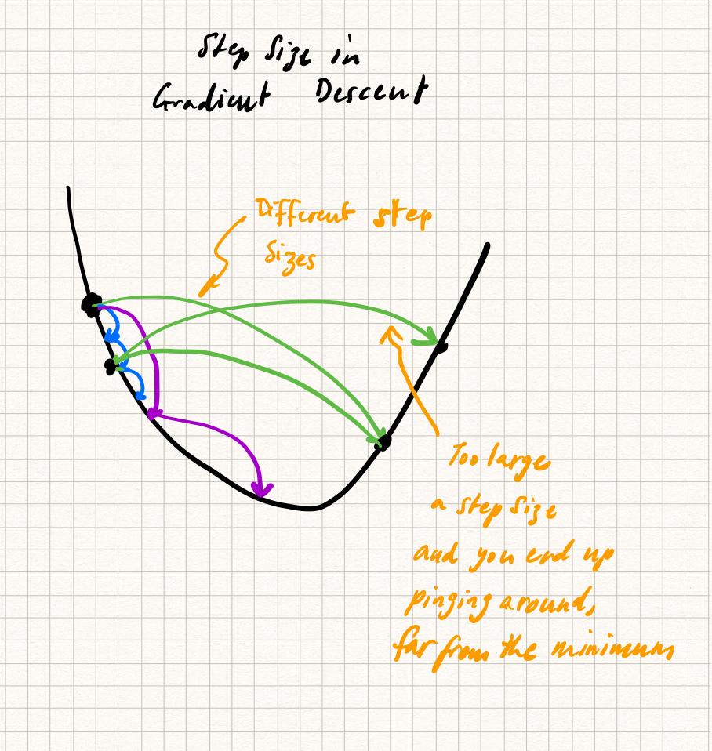

Slide 3
